Slide 1
Do Now
Fill in the blanks… some words / numbers can be used more than once.
mass, 3, 13, 14, Aluminum, number
______________ is in group 13 and period 3 of the periodic table. It has an atomic ____________ of 13 and an atomic _____________ of 26.98.
It has ______ protons, _______ electrons and ________ neutrons.
Its electrons are spread across _______ energy levels, giving it an electron configuration of 2,8,3.

Slide 2
Daily Review
CFU 1
What does the atomic number indicate the number of?
Atomic Number is the number of protons in an element and also the number of electrons in an element
Atomic Mass is the number of protons plus (+) the number of neutrons in an element
These are represented on the period table as shown in the picture.
CFU 2
The atomic number is also the number of what?
CFU 3
The atomic mass is the number of _____ in an atom.
CFU 4
To find the number of electrons in an atom we would use the ________ number.

Slide 3
Daily Review
CFU 1
The maximum number of electrons in the second energy level is?
The electrons occupy ENERGY LEVELS.
A simple model that shows how electrons exist in atoms is shown below for an atom of calcium.
More than 4 electrons in an energy level = PAIRS (clockwise direction)
CFU 2
Can there be 3 electrons in the first level?
e
First energy level contains a maximum of 2 electrons
e
e
e
e
e
Second energy level contains a maximum of 8 electrons
e
e
Ca
e
e
e
e
e
e
e
Third energy level contains 8 electrons (not a maximum)
e
e
e
e
Fourth energy level contains 2 electrons (not a maximum)
e
Calcium ELECTRON CONFIGURATION: Ca 2, 8, 8, 2

Slide 4
Metals and Non-Metals Year 8 Science

Slide 5

Learning Objectives
CFU 1
What are we going to locate on the periodic table?
Locate metals, non-metals and metalloids on the periodic table
Identify common properties of metals and non-metals
CFU 2
What are we going to identify?
Activate Prior Knowledge
How many names of metals can you think of in 2 minutes?
Write them on your whiteboard.

Slide 6
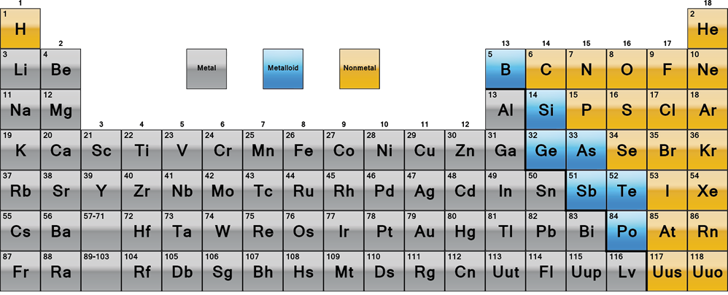
Concept Development
CFU 1
What might an element be classified as?
Elements on the periodic table are arranged according to their properties.
CFU 2
What is hydrogen classified as?
Every element is either a metal, a non-metal or a metalloid.
CFU 3
What is calcium classified as?
CFU 4
What is silicon classified as?
Notes:
Ask students to colour code the non-metals and metalloids on their periodic tables

Slide 7
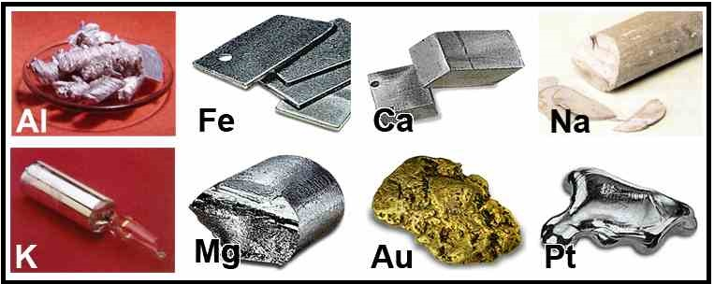
Concept Development
CFU 1
Where are metals located on the periodic table?
All elements classified as metals share common properties.
CFU 2
What property allows metals to bend without snapping?
Metals: located on the left side of the periodic table.
Common properties that metals have are:
They are shiny – metals have a smooth, shiny surface
They conduct electricity – electricity is able to travel through metals
They are malleable – metals can bend without breaking
They are solid at room temperature – except for mercury (Hg)
CFU 3
What property makes metals ideal for making electrical wires?
Vocabulary
malleable (adjective) can change shape without breaking or cracking

Slide 8
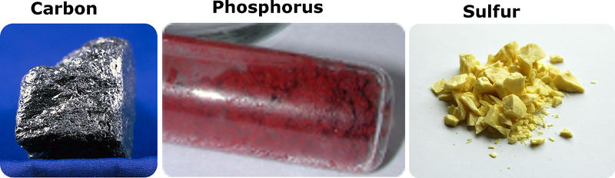
Concept Development
CFU 1
Where are non-metals located on the periodic table?
All non-metals share common properties.
Non-metals are located on the right side of the periodic table.
Common properties that non-metals have are:
They are dull – non-metals usually have a rough, non-shiny surface
They do not conduct electricity – electricity is unable to travel through non-metals (except graphite)
They are brittle – solid non-metals will break if they are bent
They may be solids, liquids or gases at room temperature
CFU 2
What property causes non-metals to break easily?
CFU 3
What property makes non-metals ideal for coating electrical wires?
Vocabulary
brittle (adjective) hard, but cannot change shape without breaking or cracking

Slide 9
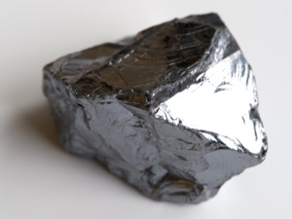
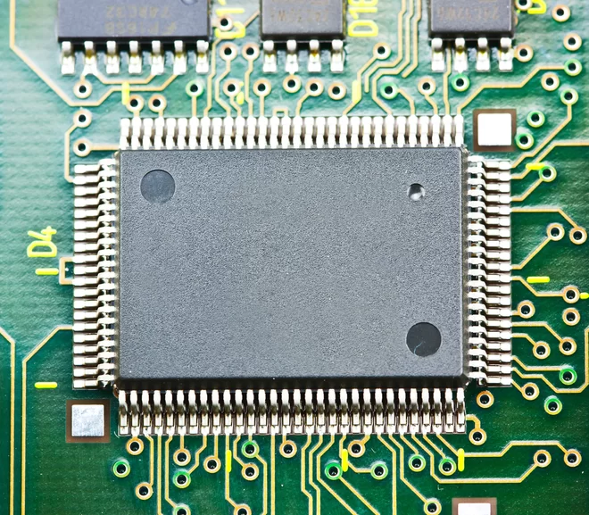
Concept Development
CFU 1
Where are metalloids located on the periodic table?
All metalloids share common properties.
Metalloids are located in a staircase shape between the metals and non-metals.
Metalloids share properties with metals and non-metals.
For example: Silicon
Shiny
Brittle
Semi-conductor of electricity
Solid at room temperature
CFU 2
What does silicon have in common with metals?
CFU 3
What does silicon have in common with non-metals?

Slide 10
Skill Development / Guided Practice
CFU 1
Does neon conduct electricity?
Elements with the same classification (metal, non-metal or metalloid) share similar properties.
CFU 2
True or false: Helium has similar properties to neon.
What is the element neon classified as?
A non-metal

Slide 11
Skill Development / Guided Practice
CFU 1
Does aluminium conduct electricity?
Elements with the same classification (metal, non-metal or metalloid) share similar properties.
CFU 2
What state of matter would you expect aluminium to be at room temperature?
CFU 3
True or false: Sulfur has similar properties to aluminium.
What is the element aluminium classified as?
A metal

Slide 12
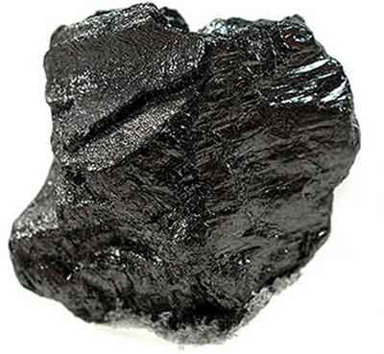
Skill Development / Guided Practice
Elements with the same classification (metal, non-metal or metalloid) share similar properties.
Carbon is a solid at room temperature. What would happen if you tried to bend it? Explain your answer.
Carbon would break if you tried to bend it. Carbon is a non-metal, so it is brittle.

Slide 13
Skill Development / Guided Practice
Elements with the same classification (metal, non-metal or metalloid) share similar properties.
An electrician want to make wires out of either copper or krypton. Which should she choose and why?
Copper – it’s a metal so it is malleable (bends) and conducts electricity. Krypton is a non-metal so it cannot do either.

Slide 14
Relevance
Identifying metals non-metals and metalloids on the periodic table helps us to understand how elements are arranged.
The differing properties of elements affects their use.

Slide 15
Skill Closure
List 3 differences between the properties of metals and non-metals.
Skill Closure
Name one element that is a metalloid.
Skill Closure
Which of the following elements are malleable?
A. Phosphorus
B. Titanium
C. Zirconium
D. Chlorine

Slide 16
Independent Practice
Answer the following questions in your workbook:
1. Identify the following as metals, non-metals, or metalloids using the periodic table.
(a) silicon
(b) fluorine
(c) uranium
(d) mercury
(e) arsenic
(f) iridium
2. For the element Selenium, use the periodic table to answer the following questions.
(a) What group is it in?
(b) What period is it in?
(c) Is it a metal, nonmetal, or metalloid?
(d) List three properties of this substance?

Slide 17
Independent Practice
ANSWERS
1. Identify the following as metals, non-metals, or metalloids using the periodic table.
(a) silicon Metalloid
(b) fluorine Non-metal
(c) uranium Metal
(d) mercury Metal
(e) arsenic Metalloid
(f) iridium Metal
2. For the element Selenium, use the periodic table to answer the following questions.
(a) What group is it in? G16
(b) What period is it in? P4
(c) Is it a metal, nonmetal, or metalloid? Non-metal
(d) List three properties of this substance? Dull, does not conduct electricity, and is brittle.

